Slide 1
FIVE GAME IDEAS
BY PAUL MARTE

Slide 2
Zombie Survival
Overview : Survive waves of zombies spawning randomly at the screen's edges.
Controls : Move, aim, and shoot in all directions.
Weapons : Start with a pistol; stronger weapons spawn over time.
Difficulty : Each wave gets harder with tougher zombies.
Scoring : Earn points for kills; survival time boosts your score.
Goal : Survive as long as possible and achieve a high score.

Slide 3
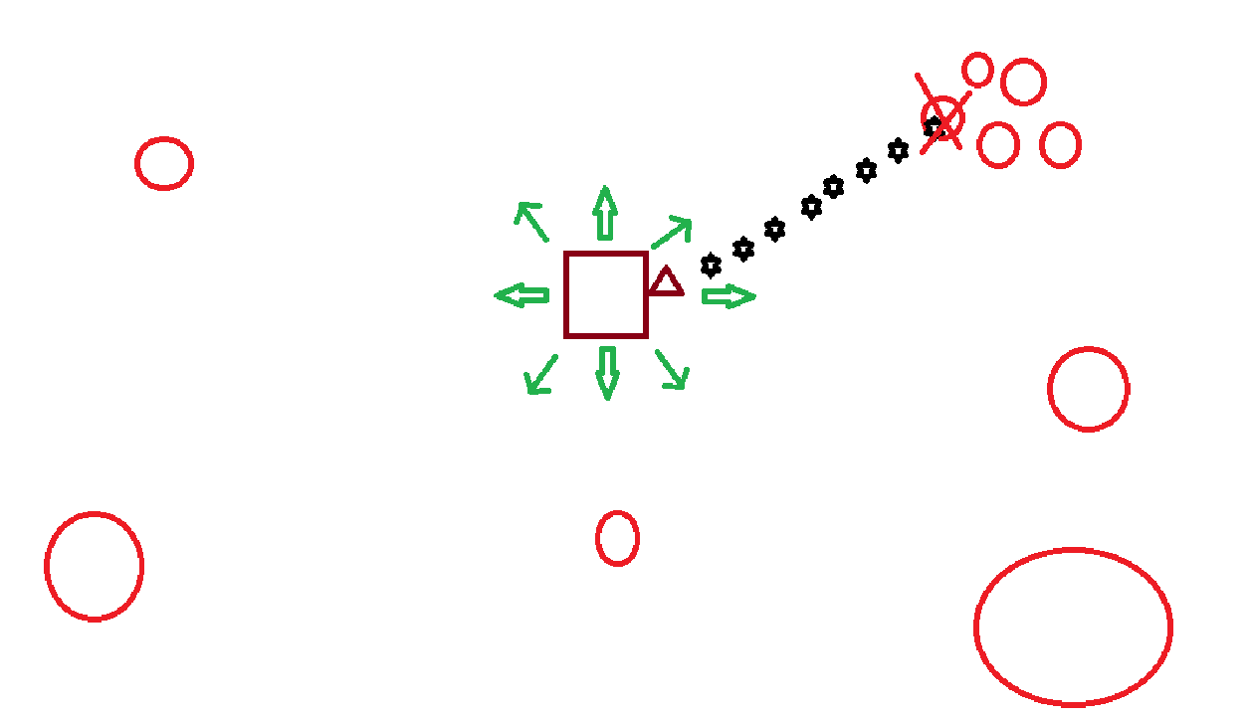
Zombie Survival

Slide 4
Bank Hero
Overview : Play as a sharpshooter, stopping a bank robbery while avoiding hostages.
Gameplay : Aim and shoot criminals; avoid hitting hostages or innocent people.
Challenges: Criminals may use hostages as shields and require multiple shots to defeat.
Scoring : Earn points for stopping criminals; penalties apply for hitting innocents.
Goal : Eliminate criminals, avoid collateral damage, and achieve the highest score.

Slide 5
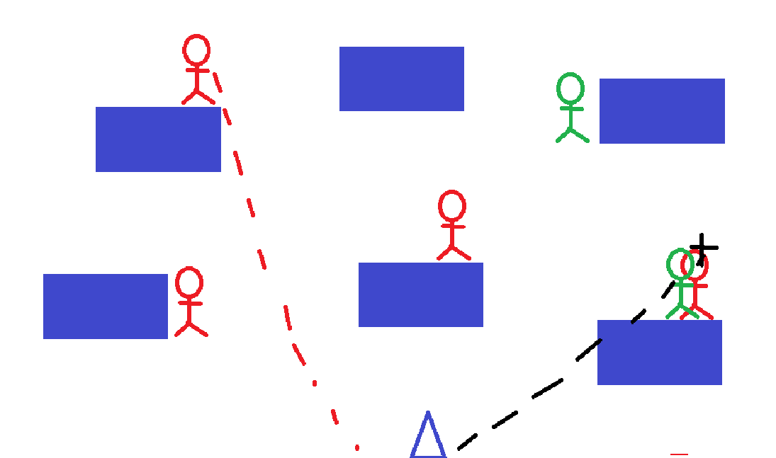
Bank Hero

Slide 6
Swat the Fly
Overview : Swat flies buzzing unpredictably across the screen.
Gameplay : Aim, click, or tap to swat flies before they escape.
Challenges: Flies become faster and more erratic with each level.
Scoring : Earn points for swatting flies; penalties for missing or hitting obstacles.
Goal : Swat as many flies as possible and achieve the highest score.

Slide 7
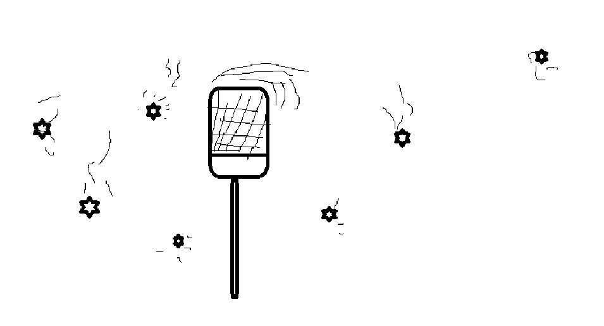
Swat the Fly

Slide 8
Independence Day
Overview : Defend Earth from alien invasions in a spaceship.
Gameplay : Move left and right, shooting alien ships before they reach the planet.
Challenges: Aliens get faster, fire back, and drop power- ups like shields or bombs.
Scoring : Earn points for destroying ships and completing waves quickly.
Goal : Survive waves, protect Earth, and achieve the highest score.

Slide 9
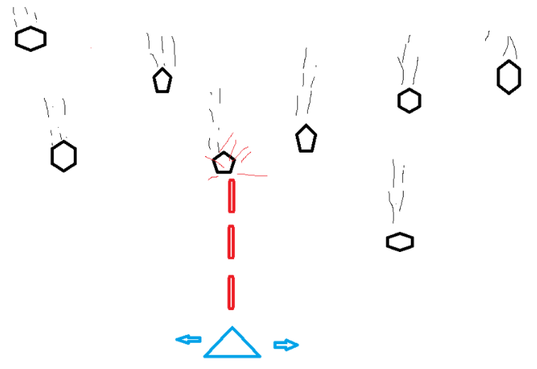
Independence Day

Slide 10
Chicken Crossing
Overview : Guide a chicken safely across a busy road.
Gameplay : Navigate traffic by moving up, down, left, or right to avoid vehicles.
Challenges: Vehicles move at different speeds, with more obstacles in later levels.
Scoring : Earn points for successful crossings and bonuses for quick or flawless runs.
Goal : Cross roads, avoid hazards, and achieve the highest score.

Slide 11
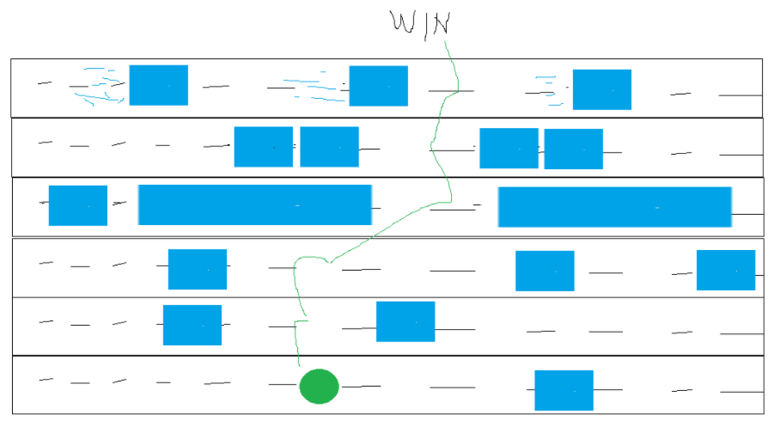
Chicken Crossing

